Slide 1
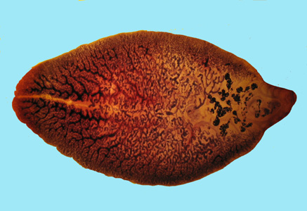
Fasciola hepatica
Morphology
1- Size is 3 X 1.3 cm
2- Flattened dorsoventrally – Bilaterally symmetrical.
3- Anterior cone is prominent with shoulder
4- Lateral margins converge.
5- Oral & Ventral suckers are equal in size.
6- Medial branches of intestinal caeca are simple.
7- Hermaphrodite – 2 highly branched testes that occupy the middle third & one branched ovary above the anterior testes / convoluted short Uterus / Vitelline glands laterally.

Slide 2
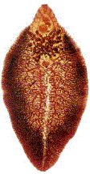
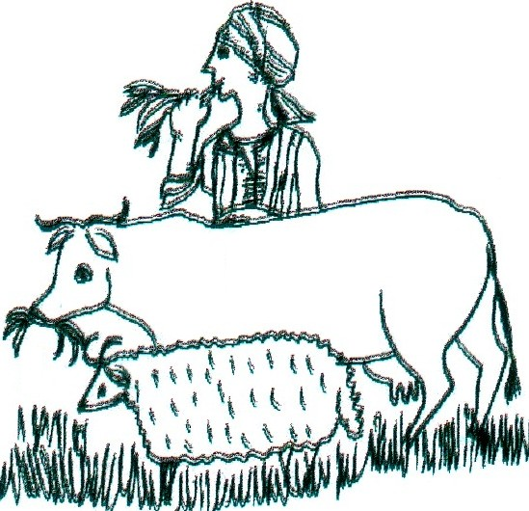
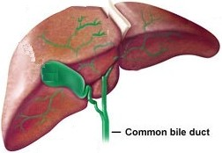
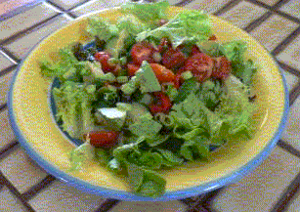
Fasciola causes Fascioliasis
Geog. Distribution:
F.gigantica cattle raising countries
Both exist
F.hepatica sheep raising countries
Final Host:
man, herbivorous animals
Habitat:
bile ducts of the liver
Diagnostic stage:
egg in stool
Infective stage:
encysted metacercaria
Mode of infection:
ingestion of contaminated raw green vegetables or water

Slide 3
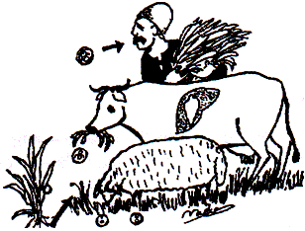
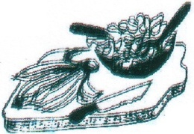
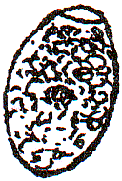
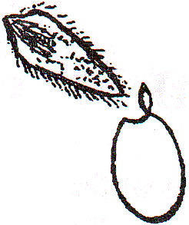
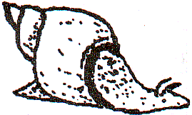
Life Cycle of Fasciola
Ingestion of contaminated vegetables & water
Infected Man
Definitive host
Mode of infection
Infected Herbivorous animals
Reservoir host
Encysted metacercaria
after
Infective stage
Egg
Diagnostic stage
Fresh water
Intermediate host
simple
tail
snail
Lepto-cercous cercaria
Hatching miracidium
L.cailliaudi
L.truncatula
F.gigantica
F.hepatica

Slide 4
Pathogenesis
Development of Fasciola inside the body of the patient
Spontaneous healing may occur
Encysted metacercaria
Ectopic site
Destruction and necrosis of liver parenchyma by migrating immature flukes
Flukes cause obstruction, inflammation, proline activity
Ectopic site
Hyperplasia of biliary epithelium and fibrous thickening of the ducts
Liver capsule
Periductal fibrosis and pressure atrophy on adjacent liver tissue
Immature fluke
adult
Minute abscesses form around eggs trapped in the parenchyma
Peritoneum
Flukes may lose way and form ectopic lesions
Excysted metacercaria

Slide 5
What happens to liver & biliary branches due to Fasciola infection?
Periductal fibrosis
Healthy tissues
Pressure atrophy on adjacent liver tissue
Immature fluke
Adult fluke

Slide 6
Clinical Picture
Digestive disturbances and diarrhoea.
Fever, urticaria, bronchial asthma
Allergic reaction to parasite byproducts
إفرازات
Pain in the right costal margin and substernal pain.
(Pain in the right hypochondrium)
Enlarged tender liver.
Cholangitis, cholecystitis and
obstructive jaundice.
Peritoneum

Slide 7
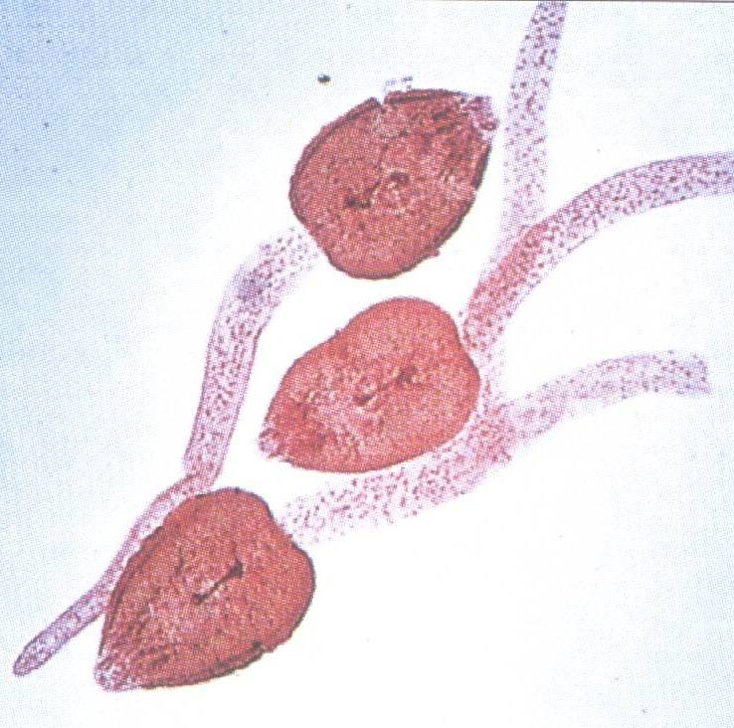
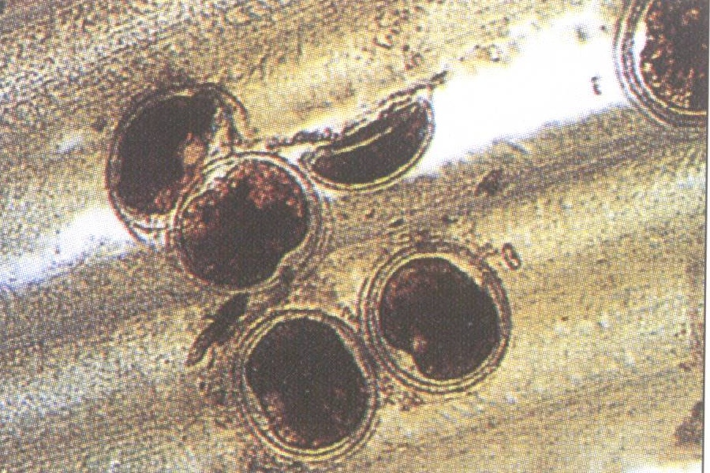
Cercariae & encysted metacercariae of Fasciola spp.

Slide 8
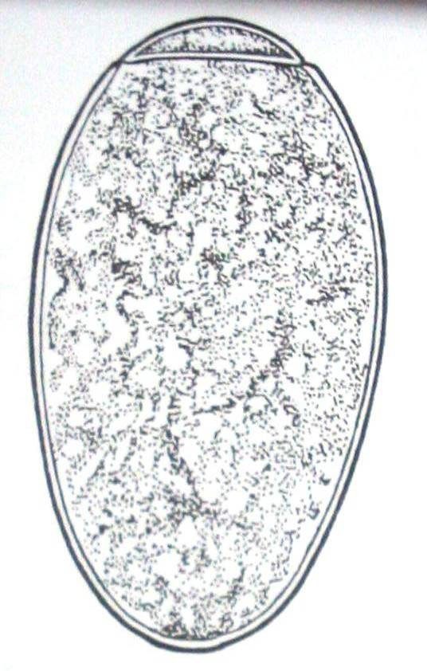
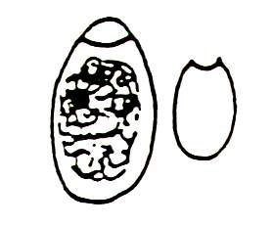
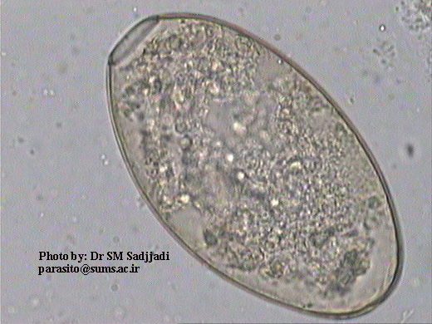
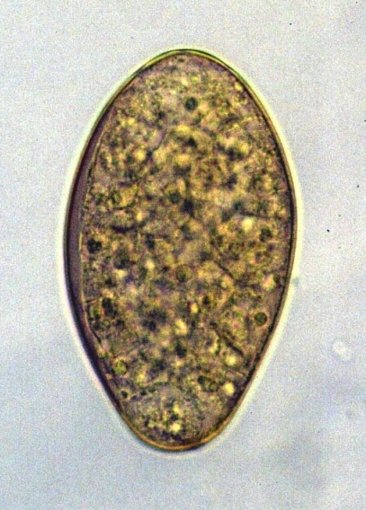
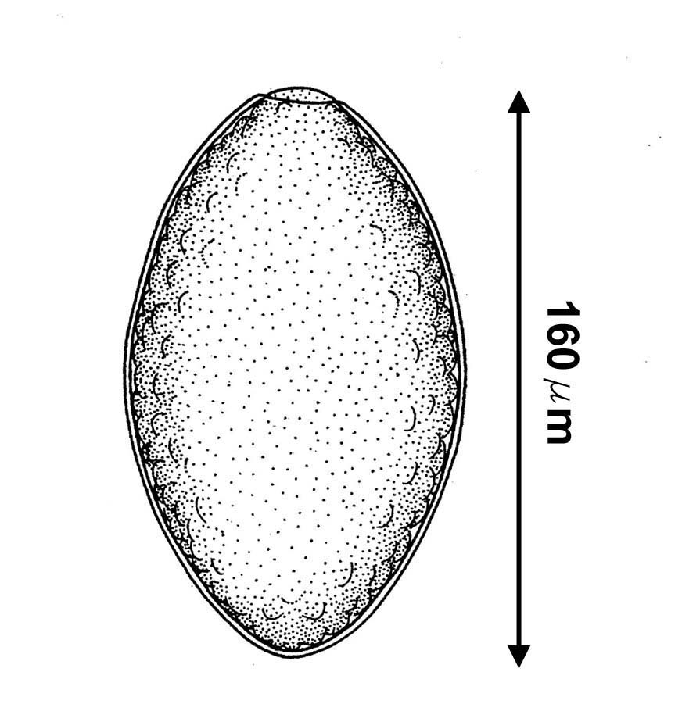
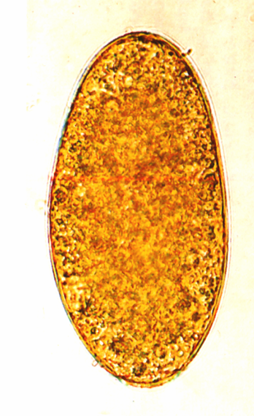
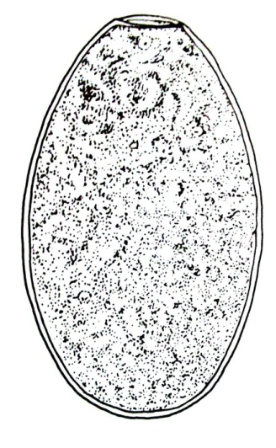
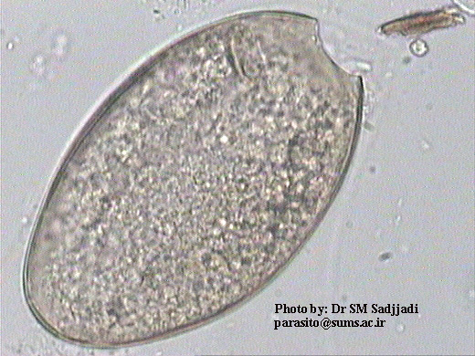
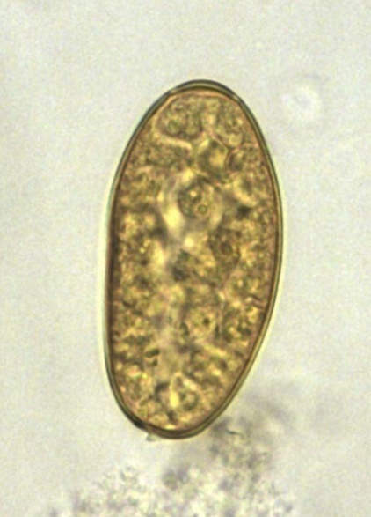
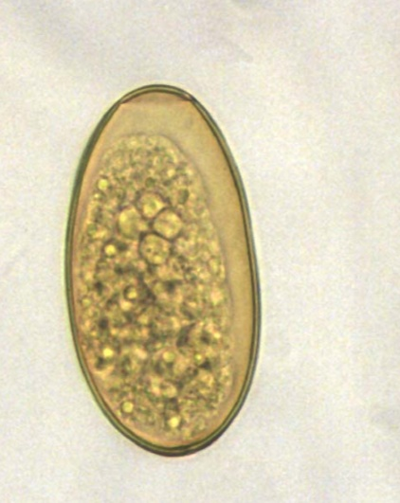
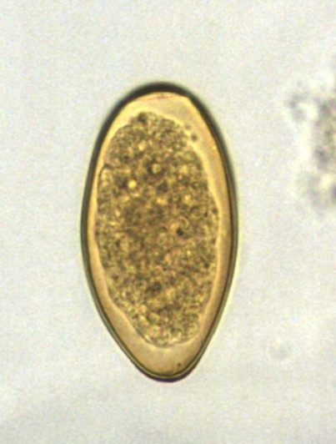
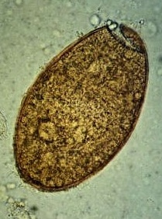
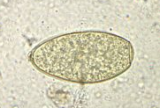
D.S
Fasciola egg
S: oval
S: 140*x70u
S: thin
C: brownish
C: immature

Slide 9
_{Endoscopy}

Slide 10
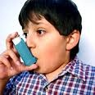
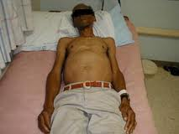
Patient suffering from obstructive jaundice
Photos of Patients Suffering from Fascioliasis
Child suffering from bronchial asthma
Skin showing urticarial rash
Patient having enlarged liver

Slide 11
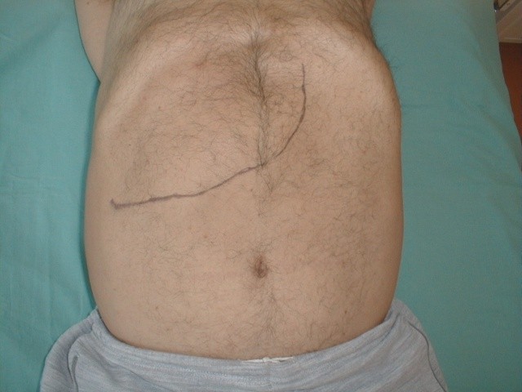
Diagnosis of Fascioliasis
احتمال
Clinically
(suggestive)
Laboratory
Radiologically
I- fever
I- Detection of eggs
II- Immunological tests
II- hepatomegaly
stool
Copro-antigens
antibodies
III- Blood examination

Slide 12
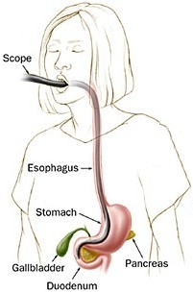
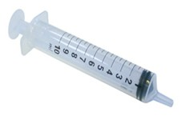
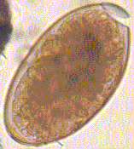
Laboratory Diagnosis
I- Detection of eggs
in faeces
or duodenal aspirate
S: 140 X 70 µ
S: oval, operculated, thin-shelled
C: yellowish
C: immature ovum

Slide 13
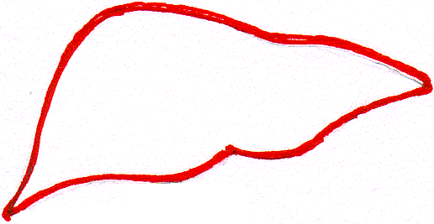
Laboratory Diagnosis
Diagnosis of Fascioliasis by stool analysis is of limited use
Why?
Infected cooked liver
Because:
1- eggs appear in stool after 3-4 months. (prepatent period)
Healthy liver
2- eggs are not detectable in the chronic phase.
3- eggs appear in stool of uninfected persons after eating liver of infected animal.
(Spurious infection – false fascioliasis)
Fasciola eggs pass in stool

Slide 14
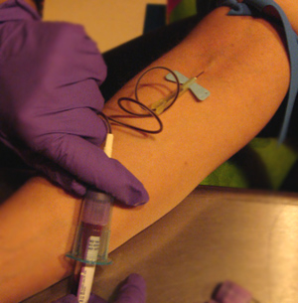
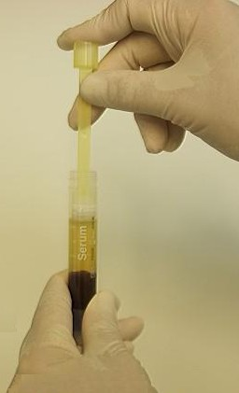
Laboratory Diagnosis
II-Immunodiagnostic tests:
Antigen or antibody detection by
Enzyme-liked immunosorbent assay (ELISA)
Immunofluorescence assay
Immuno-electrophoresis
It can detect early, prepatent and chronic infections

Slide 15
Enzyme-linked Immunosorbent Assay
Fasciola Ag
Patient’s serum
Ab linked to enzyme
substrate
wash
wash
wash
Wells coated with Fasciola Ag
To detect anti-Fasciola Ab in patient’s serum
Patient’s stool
Ab linked to enzyme
MAb
substrate
wash
wash
wash
Coating well with Fasciola monoclonal Ab
To detect Fasciola Ag in patient’s stool

Slide 16
Immunofluorescence assay
Add drops of patient’s serum
Slide coated with Fasciola antigen
wash
Add fluorescene-labeled anti-antibody
wash
Examine the slide using the fluorescence microscope

Slide 17
Laboratory Diagnosis
III- Blood Examination
High eosinophilia (up to 80%)
Anaemia

Slide 18
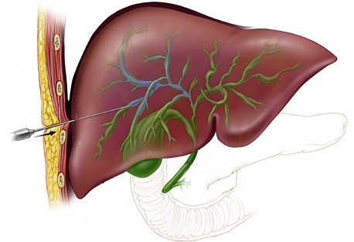
Diagnosis (continued)
Radiological imaging
Dye is injected through the needle
Percutaneous cholangiography صبغة القنوات المرارية يتم حقنها عن طريق الجلد
Ultrasonography

Slide 19
Endoscopic retrograde cholangiography
منظارمع أشعة بالصبغة لفحص القنوات المرارية

Slide 20
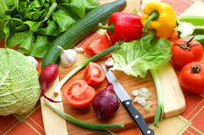
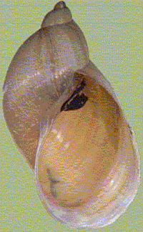
Treatment
Triclabendazole , Bithionol OR Praziquantel
Prevention and Control
- Mass treatment
- Proper washing or cooking of aquatic vegetations
Soaking of vegetables in vinegar or potassium permanganate
- Safe water supply
- Snail control

Slide 21
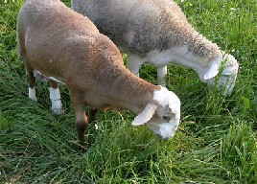
Parasitic Pharyngitis or Halzoun
A condition caused by ingestion of fresh RAW sheep and goat livers infected with Fasciola.
A condition caused by Linguatula serrata found in the nasal and respiratory passages of the dog.
((نيئة
Nymphs are developed in viscera of sheep & goats

Slide 22
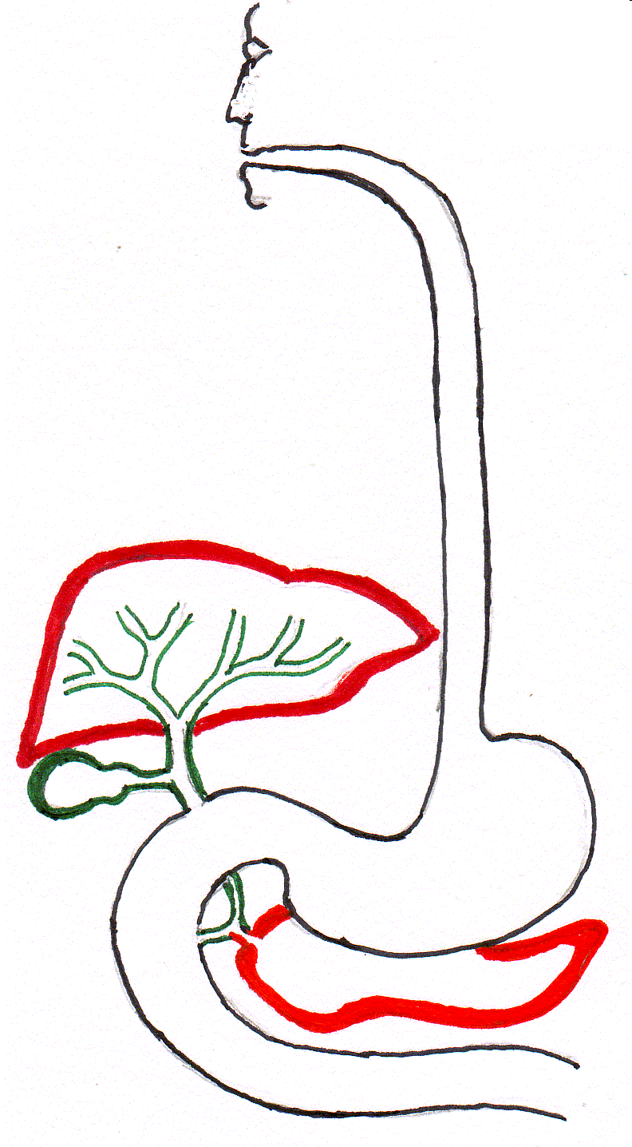
Infected sheep
- Mode of infection:
Man becomes infected by eating improperly cooked infected viscera of sheep, goats and rabbits containing nymphal stage.
- Treatment:
Gargling with alcoholic
drinks, emetics.
Tracheostomy.
- Control:
Proper cooking of animals tissue.
nymph
Healthy liver
Infected goats
Infected rabbit

Slide 23
False fascioliasis
Adult Fasciola
Adult Fasciola
Ingestion of infected cooked liver
Ingestion of encysted metacercaria
Ingestion of Infected raw liver
Healthy liver
Diseased liver
Healthy liver
False fascioliasis
No eggs in stool
Fasciola egg in stool
Fasciola egg in stool
Fascioliasis
Halzoun

